Slide 1



SOLUTION DOCUMENT

Slide 2
Maniac Team
Aniket Ojha
Priyansh Jinwala
Shweta Singh
Arfa Aslam Bargir
Qiyamuddin Ghaws Khan
Sombir
Balaji.G
Ramzan Ali
Ziyaulhaq Khan
Hanesh Sunil Jogani
Sakshi Zalavadia

Slide 3
TECH STACK
1

Slide 4

Technology
Python
Dependencies
AWS
AWS API Gateway
AWS Secrets Manager
AWS Lambda
AWS Relational Database Service (RDS)

Slide 5

FLOW OF THE PROJECT
2

Slide 6
Input To The API
Firstly the user will enter his/her Input
Repository Name
Date range
Example
Repository Name - hashicorp/consul
Here hashicorp is the username
Whereas consul is the repository name
Date range - 2019-12-01 - 2019-12-31
Here 2019-12-01 is the start date, while 2019-12-31 is the end between which the search has to be done from

Slide 7
Output From The API
Here the User will be shown the output in the JSON Format
Company domain name
Total number of commits
Total number of contributors
Example
Sample output will be as follows consisting of company name, total number of commits and total number of unique contributors
{
"microsoft": { total_contributions: 50, unique_contributors: 10 },
"hashicorp": { total_contributions: 15, unique_contributors: 12 } ,
"gmail": { total_contributions: 50, unique_contributors: 11 } ,
"cloudflare": { total_contributions: 52, unique_contributors: 10 }
}

Slide 8
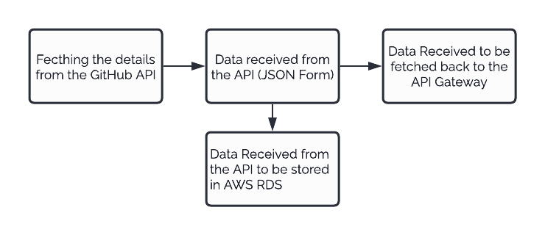
AWS API Gateway
API Gateway will provide our project with high scalability and availability
Main working starts from here.
Here we will be working with AWS RDS Instance, AWS Lambda Function, AWS Secret Manager as well as upon the API Gateway as well.

Slide 9
STATUS CODES
3

Slide 10
Status Codes
200 OK will be shown for the requests which have been successfully fetched.
400 Bad Request will be shown in cases when there is any issues from the client side like wrong syntax or invalid framing of the requests.
404 Not Found will be shown for the requests which server cannot find.

Slide 11
BLOCK DIAGRAM

Slide 12
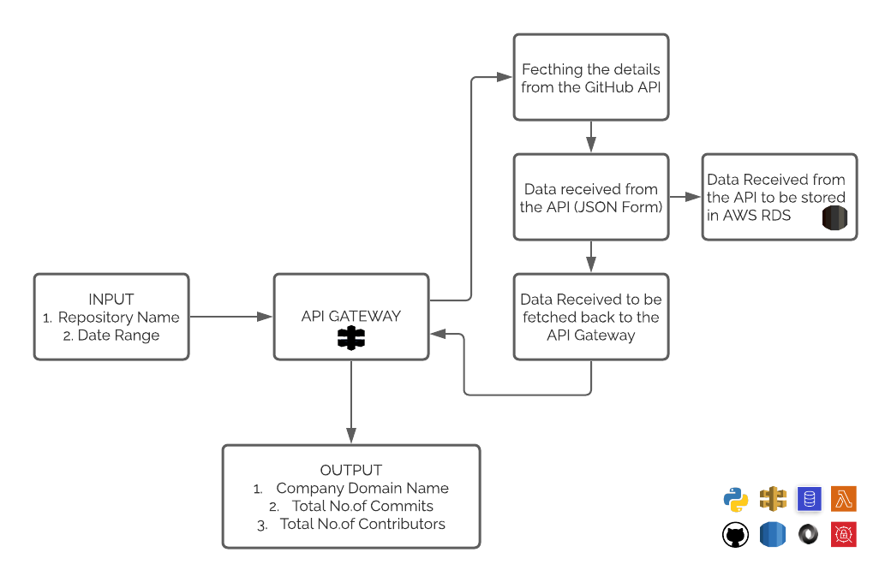

Slide 13
Dates & Milestones
Tasks | Date
Interacting with Python and Github | 04|07|2021- 05|07|2021
Processing the Json data received from the API | 06|07|2021- 07|07|2021
Fetching the processed data back to user | 08|07|2021- 09|07|2021
Starting with AWS RDS Instance | 11|07|2021- 13|07|2021
Working upon the Lambda Function | 14|07|2021- 16|07|2021
Testing on how to store data to AWS RDS | 18|07|2021- 20|07|2021
Testing the API Gateway | 21|07|2021- 23|07|2021
Resolving errors if any found | 25|07|2021- 27|07|2021

Slide 14
Weekly Planner
 | WEEK 01 26/06/2021 | WEEK 02 03/07/2021 | WEEK 03 10/07/2021 | WEEK 04 17/07/2021 | WEEK 05 24/07/2021 | WEEK 06 31/07/2021
BRD | DONE
Solution Document Environment Setup |  | DONE
Development Milestone-1
Development Milestone-2
Develop Demo the increment, Test Milestone - 3
Develop Final Demo Test Results User Acceptance Document

Slide 15
THANKS!
Any questions?
Link - https://github.com/Hanesh-Jogani/GitHub-Contributor-Aggregator

